Slide 1

Mobile Games Development 1 Presentation

Slide 2
Contents
Javascript overview
Technology within mobile games
Technical design
Techniques used
Overview of MGD 1
Further development to MGD 1

Slide 3
Javascript overview
What is Javascript?
Dynamic programming language
Webpages
Advantages
Less server interaction needed
No compilation required
Disadvantages
Security
Single error can break code

Slide 4


Technology Within Mobile Games
Technology progression
Directional games
Puzzle games
Touchscreen
AR/VR
Online Games
Progression of mobile games
Snake
Candy crush
Pokémon Go
PlayerUnknown’s Battlegrounds
Technologies
Web Apps
Native Apps
Hybrid Apps

Slide 5

Technical Design
UI
Try to keep everything neat
Low number of clickable UI
Accessibility
Colour scheme
Adjustable UI (fonts, size)
Light-sensitive

Slide 6



Techniques
Different techniques when creating mobile games can be :-
Augmented Reality
Virtual Reality
Online server games
Examples of these techniques in games :-
Augmented Reality – Pokemon Go
Virtual Reality – Minecraft VR
Online server games – Fortnite Mobile

Slide 7
Techniques to circumvent issues
Aspect ratio
Scaling UI
Wider viewport
Visibility
Touch
UI placement
Scale
Notes:
When creating mobile games specifically, there will be issues that will arise and you will have to find ways around this. One issue could be that different mobile devices have different aspect ratios, meaning the screen will either be larger or smaller that anticipated. To combat this, a ui scaler can be implemented so the UI fits on the screen in a way that seems fit. Also if the user is using a wider screen, you will have to decide whether to let the player see more of the screen or if this gives the player an advantage over players with smaller screens, then you will have to zoom in the game so that this will not be an issue.
Another issue could be that if a player has a virtual joystick on screen, will using it block the players visibility of the game, making it much harder to see where they are going or seeing enemies and such. A good way around this would be to move a player by touch, or if a virtual joystick is a necessity then to think more about the placement of it so that it does not block the players view. Scaling the joystick will also help.

Slide 8

Web App vs Native App

Slide 9
Web App & Native App
Web App
App made to be played on browser only
Doesn’t need to be downloaded.
Native App
App which is to be downloaded on phone
Fewer restrictions

Slide 10
Web App
Advantages
No need for app store approval
Can be manipulated to work on older devices
Much easier and cheaper to build compared to a native app
Disadvantages
Hard to become popular as it is harder to find
Cannot function if offline
Will feature less attractive features than in native apps

Slide 11
Native App
Advantages
Faster performance on the device
Online connection is not needed to run the app
Allow better use of phone’s features such as camera and microphone
Disadvantages
App approval from app stores can take long to achieve
Maintenance is hard to maintain
App must be developed for each individual platform

Slide 12
Hybrid App
Apps that can work on both web and native.
Advantages
Cross platform
Offline Access
No need for immediate app store approval
Disadvantages
Time and cost
Maintenance

Slide 13
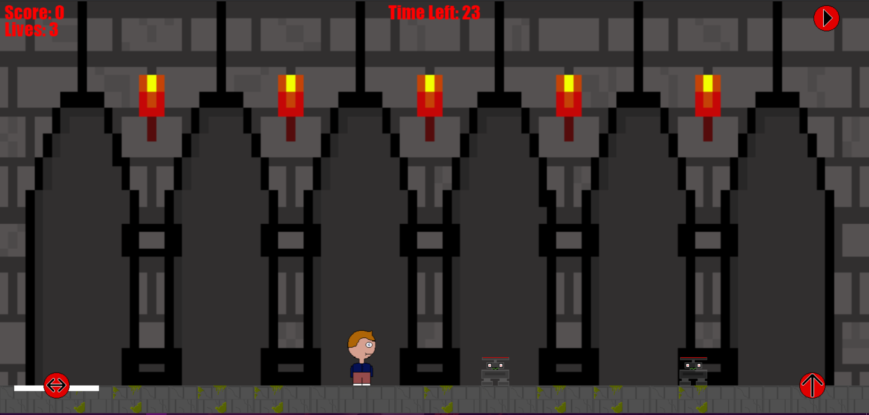
Overview of MGD 1
Work completed
Dungeon scroller game
Self-made sprites
Working collision with enemies
Hybrid App
Work which could be fixed
Player movement
Enemy movement
Floor collision

Slide 14
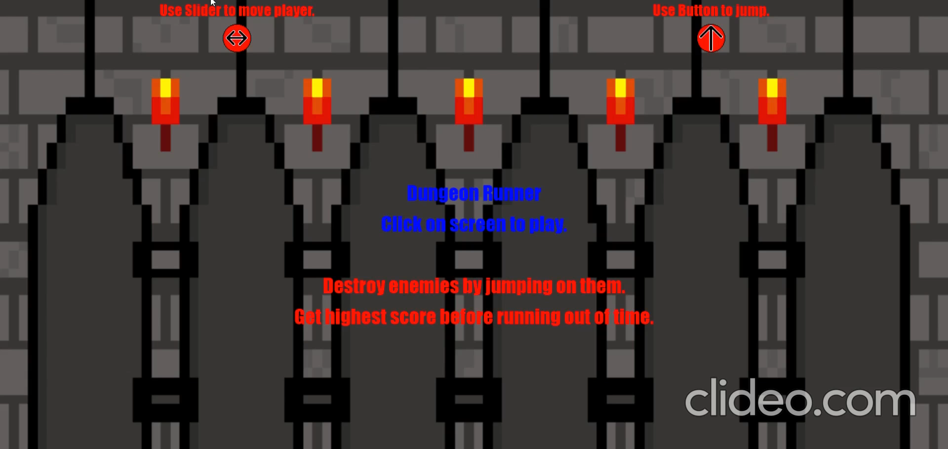
Demo Video

Slide 15
Experience of coursework
General experience was good.
Initially there were some struggles
Once picked up, it was good to work with.
Notes:
My general experience with this coursework was very good, I believe I have benefitted from this experience as it is a new language I can now say I have come to terms with. Initially, I struggled as it was a completely new language and I wasn’t sure of what I was doing.
Once I started to understand the language more, I enjoyed working with it as it didn’t take long to pick up, and was simpler to work with compared to other languages I have worked with before.

Slide 16
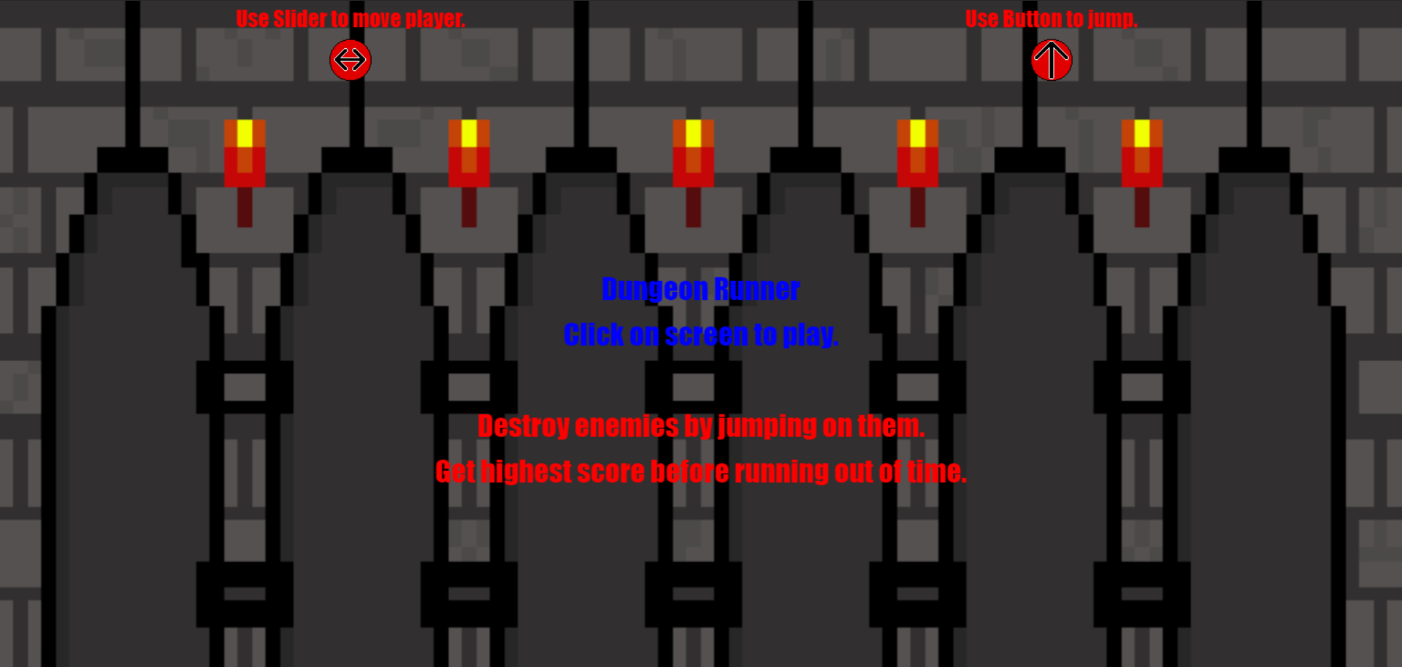
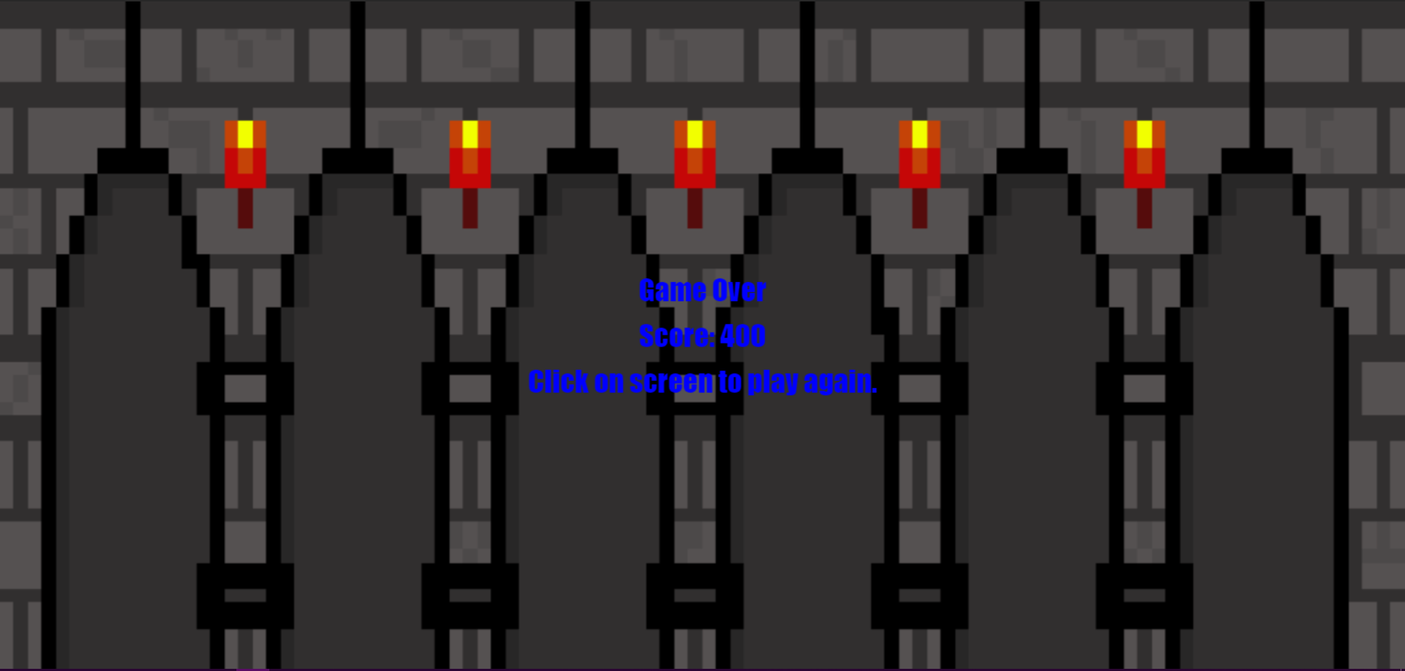
Further development to MGD 1
Later additions :-
Multiple enemy types
Shooting enemies
Enemies that require multiple hits
PCG level layouts
Missing floor
Upper levels
Levels to the game
Clear the level then progress
Database to contain score

Slide 17
Further Development
Enemies
Multiple hits- Bounce
Shooting enemies – Add crouch
Hazards and level design
Disable floor already added
Upper floors
Multiple levels
Increased score
Faster Enemies
Notes:
When it comes to implementing this extra functionality, thought has already been put into creating these, however, with the deadline closing, I thought it would be best to leave these out for now and return at a later to implement them.
With the extra enemies, The enemies that would require an extra hit would start with a protective shield around them which would have to be jumped on first to destroy it, this would result in the player bouncing back up, which the player would have to control to either land back on the enemy’s head or to land and then return to destroy it.
The enemies that can shoot. The player would be given extra functionality to crouch instead of just jumping over the bullets, if the enemies are also given the ability to jump.
When adding the new level designs, the ability to remove the floor is already added to the code, however, without the collision, it was not useful yet.
The upper floors would be extra levels which the player would have to jump on either to dodge enemies or to reach enemies on the platform.
With multiple levels, the higher the level the more score the player would achieve for destroying an enemy, however, the enemies would also increase speed to make the levels more challenging.

Slide 18
References
Freeman, J. (Unknown). 4 fundamentals of mobile game design. [online]. TechBeacon. Available at: https://techbeacon.com/app-dev-testing/4-fundamentals-mobile-game-design [Accessed 29th Dec. 2020].
Island Echo. (2020). The evolution of technology and mobile games. [online] Island Echo. Available at: https://www.islandecho.co.uk/the-evolution-of-technology-and-mobile-gaming/ [Accessed 2nd Jan. 2021].
iTriangle Technolabs. (2020). Web Apps vs Native Apps: Advantages & Disadvantages. [online] iTriangle Technolabs. Available at: https://medium.com/@itriangletechnolabs/web-apps-vs-native-apps-advantages-disadvantages-45f0fb019d19 [Accessed 4th Jan. 2021].

